Slide 1

In Search of Food Justice: Variation in California Asian American Food Security
Joshua Lin

Slide 2
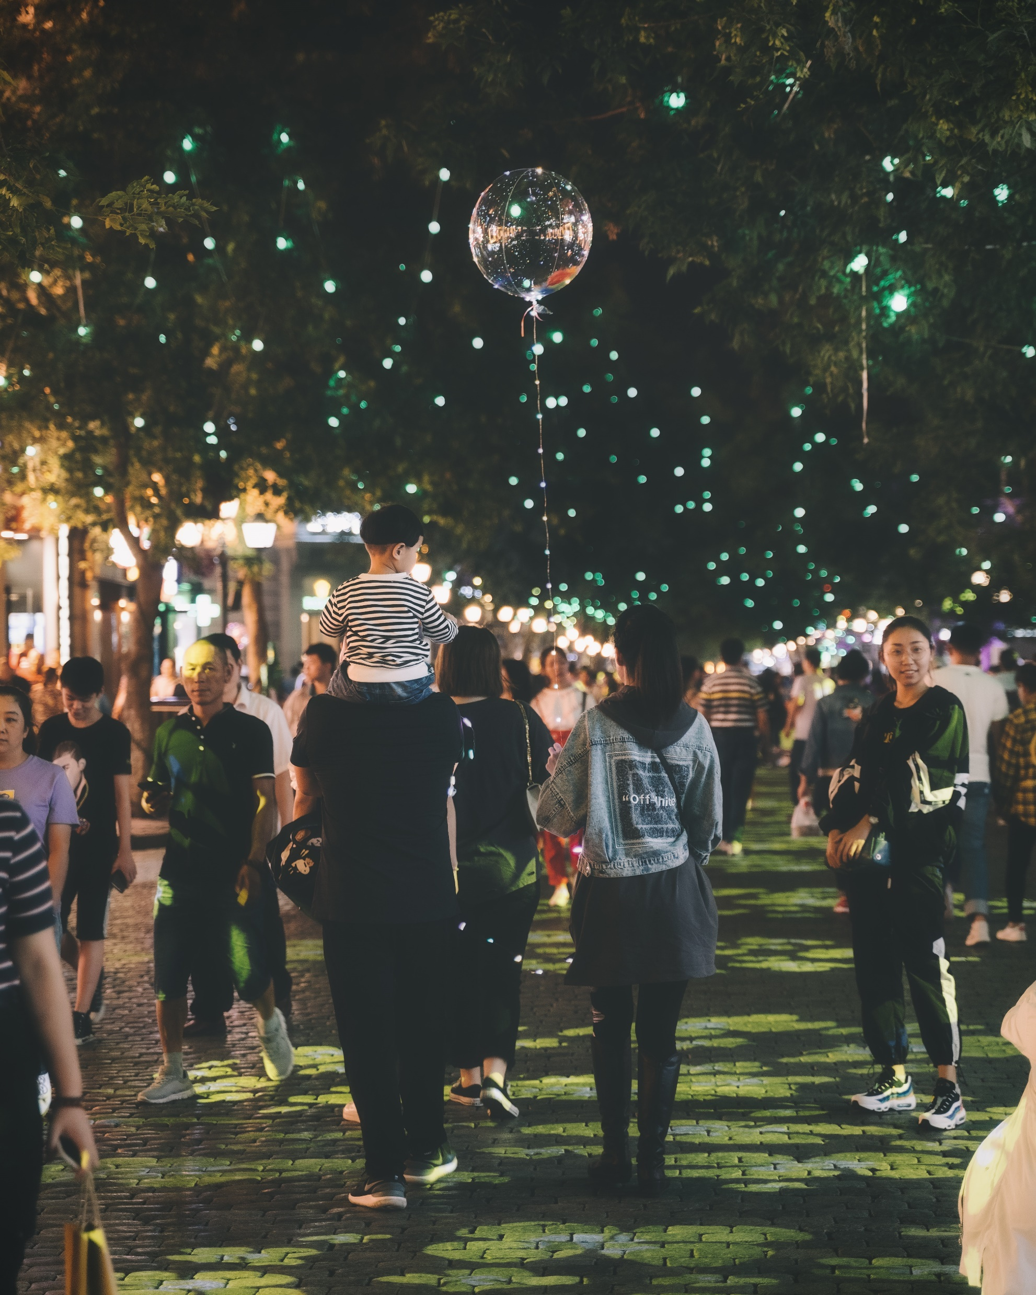

The California Asian American Community

Slide 3
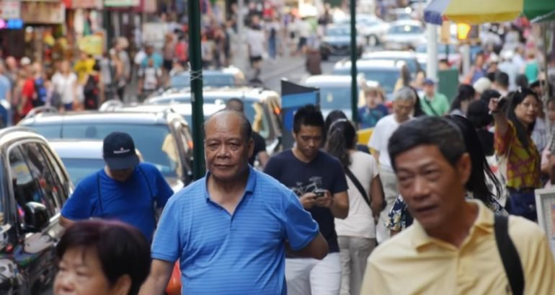
As of 2010…
Population size: 5,556,592
Dominant ethnic groups
Filipino
Vietnamese
Chinese
Japanese
Korean
Indian
Background | Methods | Results | Discussion | Conclusion

Slide 4

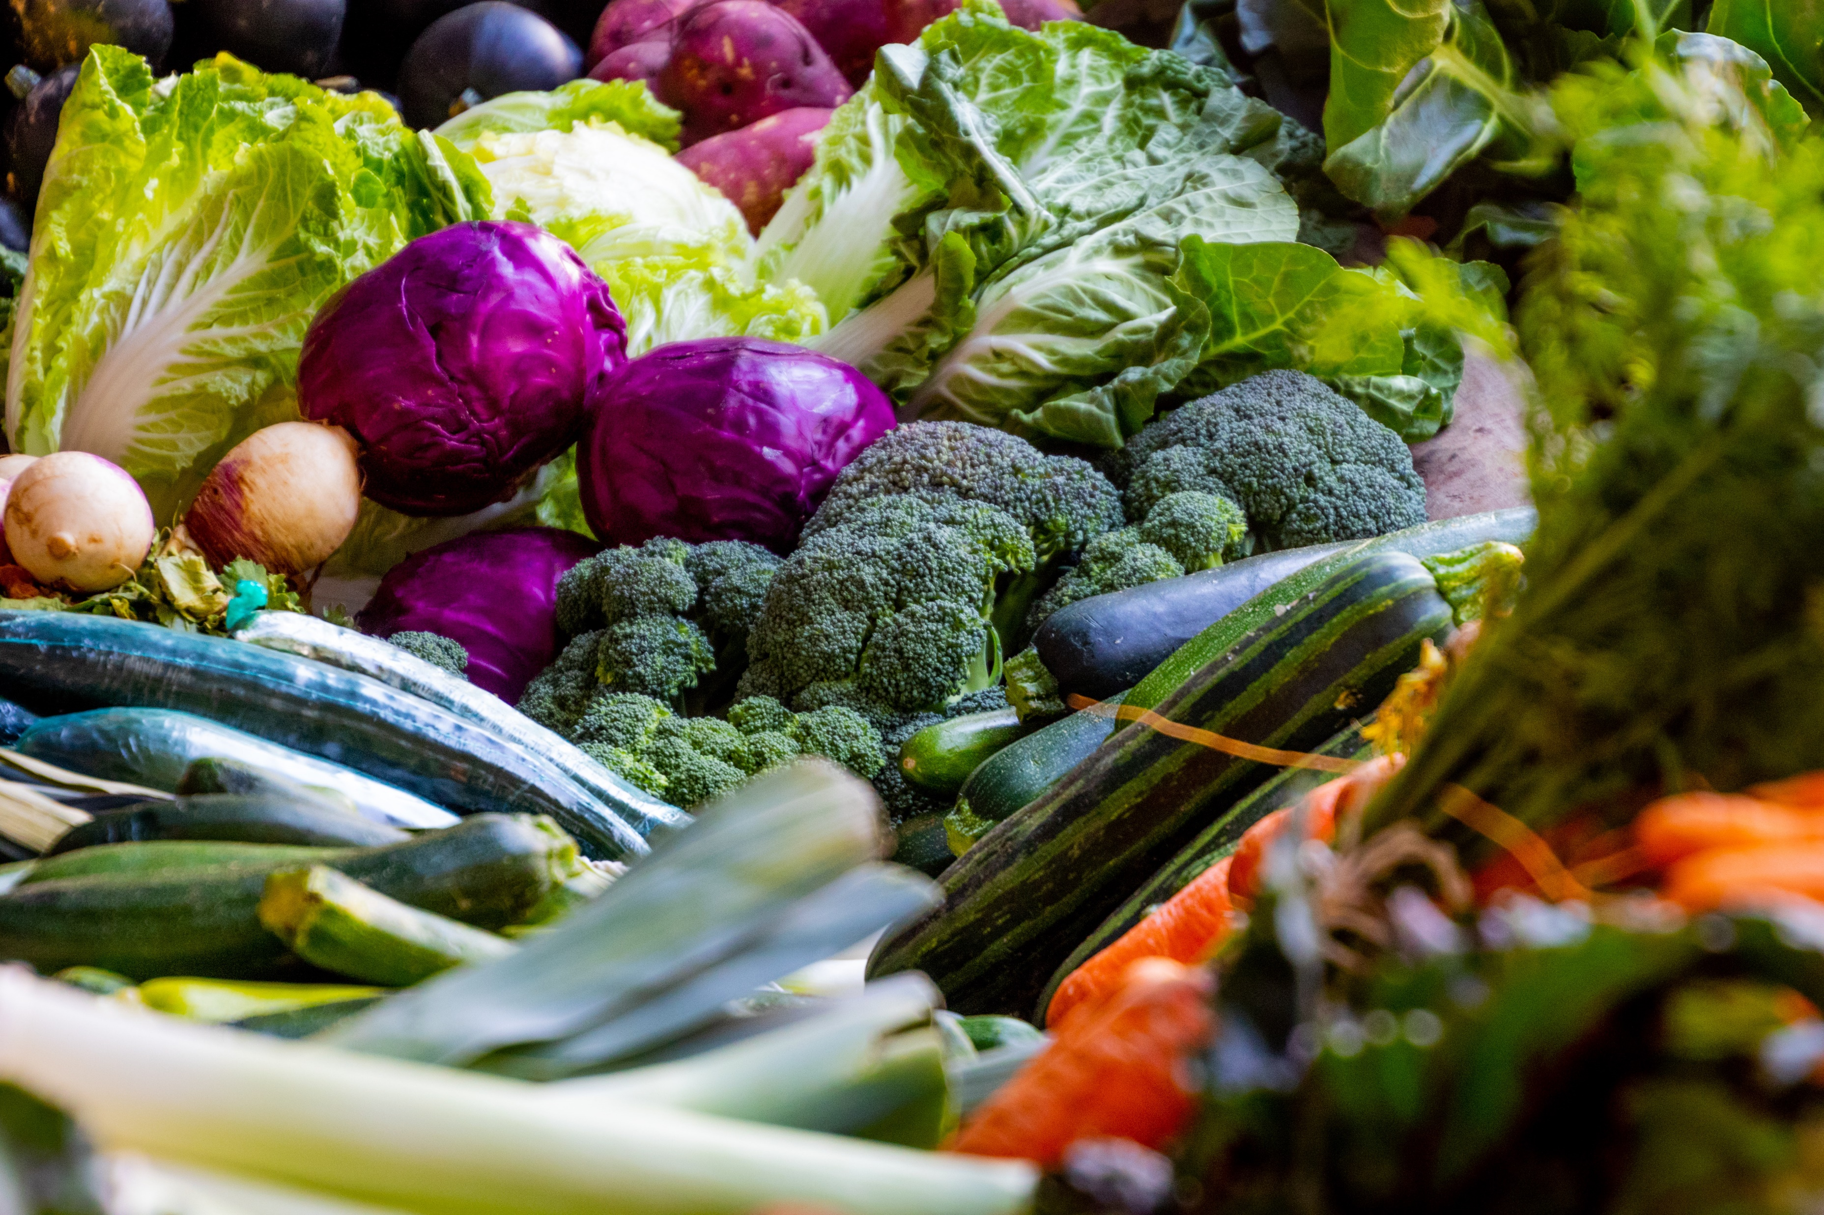
What is Food Security?

Slide 5

The Food Insecurity Experience Scale
Adapted from FAO 2020
Relative certainty regarding ability to obtain food
Compromising on food quality and variety
Reducing food quantity, skipping meals
No food for a day or more
Food Security to Mild Food Insecurity
Moderate
Food Insecurity
Severe
Food Insecurity
This person has:
Insufficient money or resources
Uncertainty about ability to obtain food
Probably skipped meals or ran out of food occasionally
This person has:
Run out of food
Gone an entire day without eating at times during the year
Background | Methods | Results | Discussion | Conclusion
Notes:
What is food security/insecurity?
“consistent access to and availability of enough food for all members of a household to lead an active and healthy lifestyle” (Becerra et al. 2018)
This might be through farmers’ markets, urban agriculture projects, etc.
Picture
Provided by the UN Food and Agriculture Organization, this is a Food Insecurity Experience Scale
Different degrees of food security and insecurity
For the purpose of my project, I’ll be looking at moderate and severe food insecurity together

Slide 6
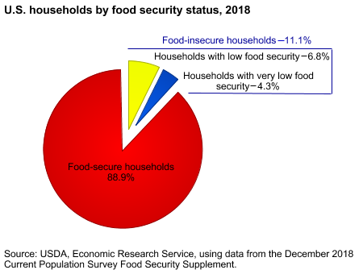
Background | Methods | Results | Discussion | Conclusion
Notes:
Graph
2018, national average food insecurity 11.1%
Where do Asians lie?
USDA ERS state that 10% of “Other races/ethnicities” are food insecure?
Other research report a rate of 10% for the national Asian American population, but is this true for each Asian American ethnic group?

Slide 7
Central Research Question
Does food security vary based on Asian American ethnicity?

Slide 8
Sub-Questions
What is the effect of assimilation/acculturation?
Is there a difference between Asians in rural versus urban settings? Between genders?
What steps have public and private organizations taken to address food insecurity?

Slide 9


Methods
Quantitative Analysis
Conducted regression analysis of ethnic food security data
Control: non-Asian groups
Explored trends in
Assimilation proxies
Location
Gender
Background | Methods | Results | Discussion | Conclusion

Slide 10

Methods
Qualitative Analysis
Interviewed food security experts, a CalFresh officer, community leaders
Extrapolated themes from responses
Used themes to supplement statistical findings
Background | Methods | Results | Discussion | Conclusion

Slide 11

Results

Slide 12
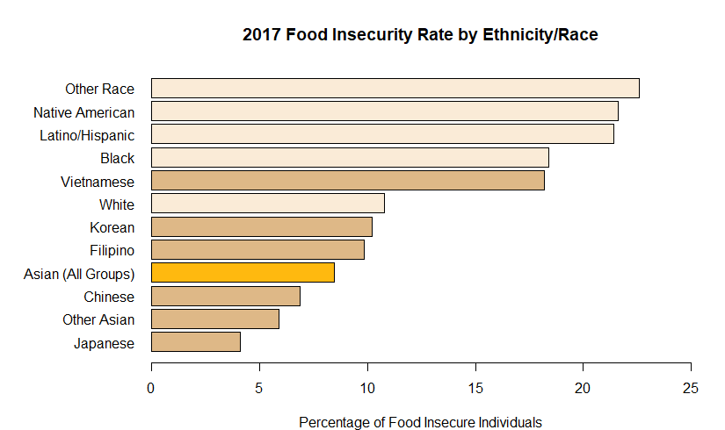
Background | Methods | Results | Discussion | Conclusion

Slide 13
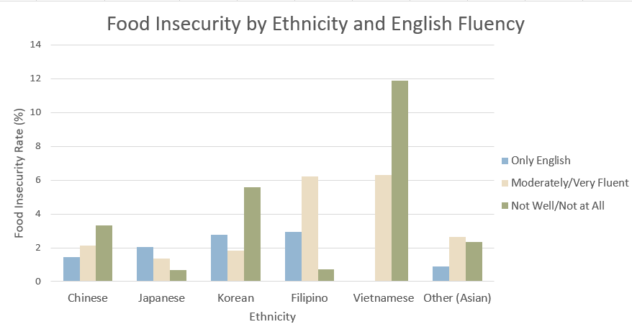
Background | Methods | Results | Discussion | Conclusion

Slide 14
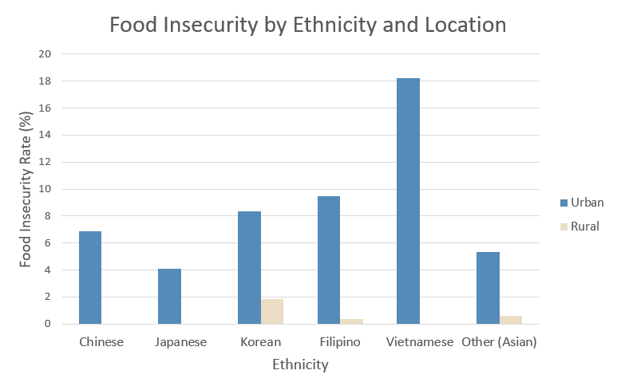
Background | Methods | Results | Discussion | Conclusion
Notes:
Tests were inconclusive
Only 78 of all Asian respondents said they lived in a rural area
There were only a handful of Koreans. Filipinos, and Asians of other ethnicities who stated they were food insecure.
Therefore, test was inconclusive that rural Asians more likely to be insecure

Slide 15
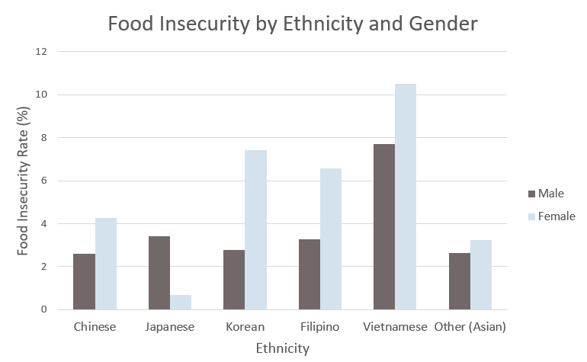
Background | Methods | Results | Discussion | Conclusion

Slide 16



Interview Topics
Initial Perception of Asian American Food Security
Community, Public, and Private Initiatives
Anecdotes and Theories
Background | Methods | Results | Discussion | Conclusion

Slide 17


What Does It All Mean?

Slide 18
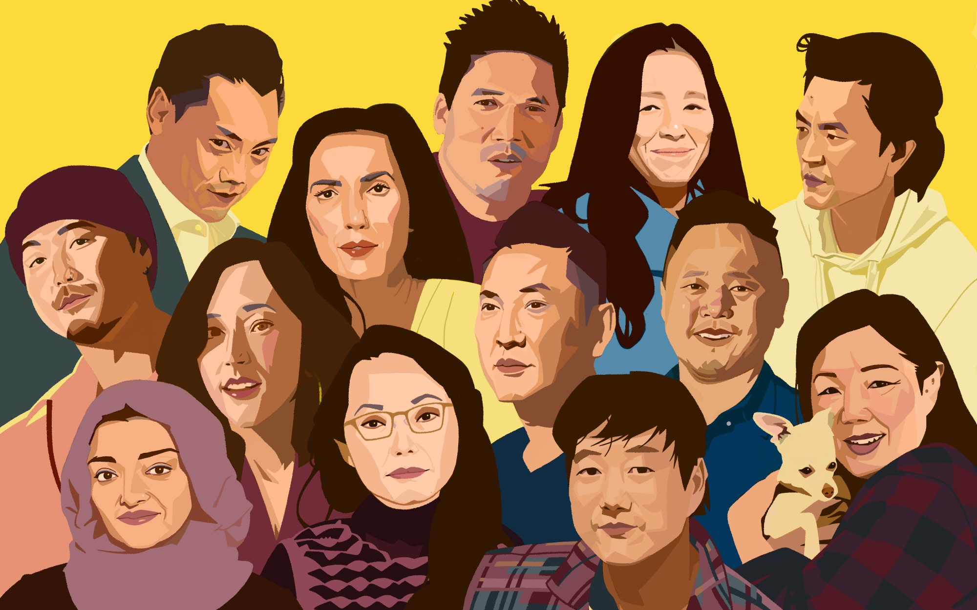
The Asian American Experience
Certain trends across the board
Variation in data suggests:
Varying access to wealth and social capital
Unique migration histories
Disproves homogenization of all Asian Americans
Marginalizes certain ethnic groups
Background | Methods | Results | Discussion | Conclusion

Slide 19
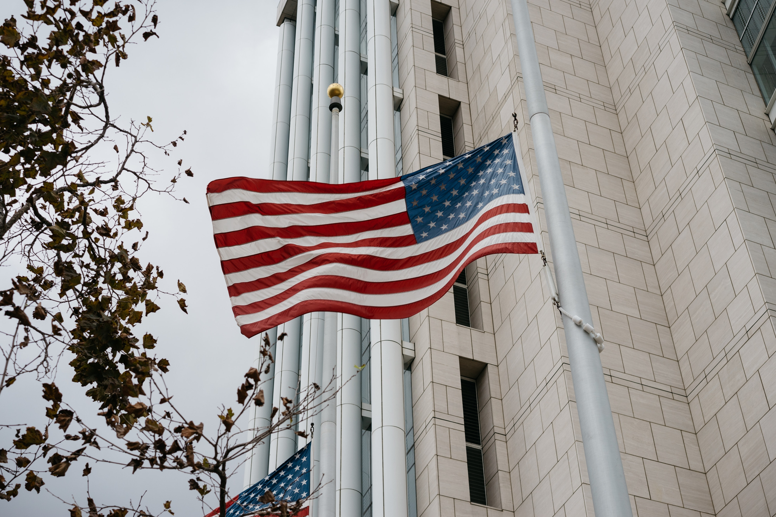
The Role of the State
Low degree of government initiative
Limited outreach
Shortage of resources
Piggyback on work of non-profits
Exposes flippant attitude towards Asian American issues
Background | Methods | Results | Discussion | Conclusion

Slide 20
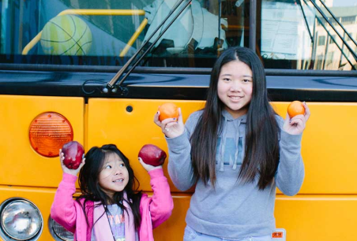
Piecing It
Together

Slide 21
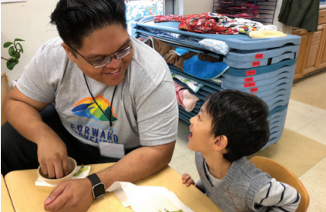
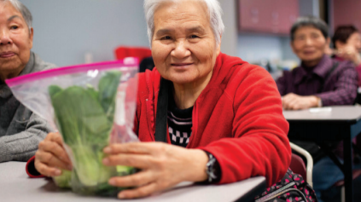
In Closing
Limitations
Scarce data
Novice statistic skills
Interviews biased towards LA county and the Bay Area
Next steps
Conduct more interviews
Clean up data analysis
Background | Methods | Results | Discussion | Conclusion

Slide 22
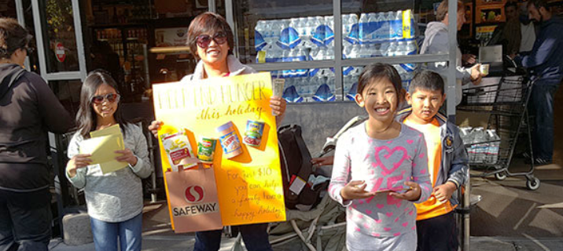
In Closing
More work and research need to be done
Increase government support
Conduct data disaggregation
Expand outreach as a whole
Why does it matter?
Deepens understanding of the Asian American community
Illustrates prevalence of hunger
Background | Methods | Results | Discussion | Conclusion

Slide 23
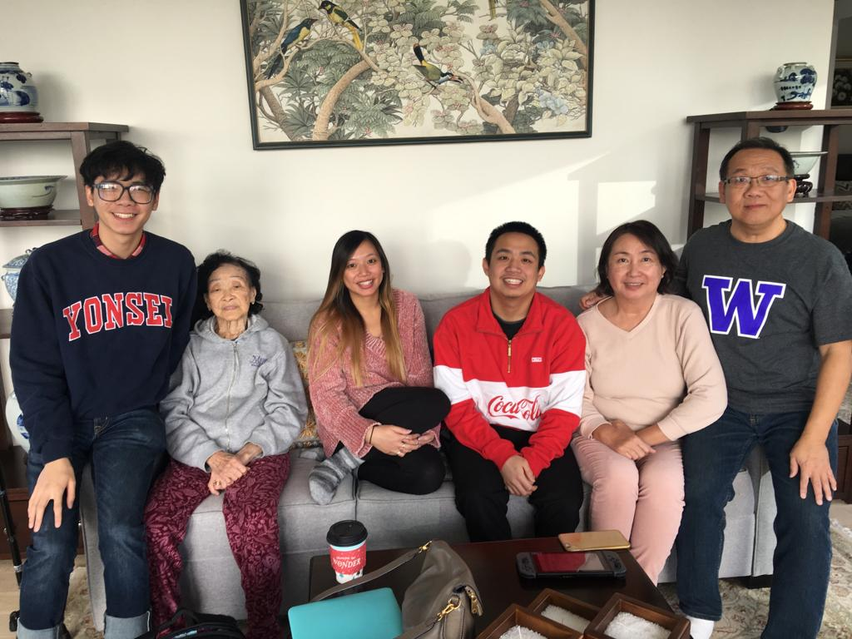
Acknowledgements
My family
ESPM175 Team: Sam, Tina, Leslie, Roxy, and Jessica
Kathryn de Master
Everyone I interviewed
My workgroup: Cal’s Next Top Modelers
All my friends in ES and across Berkeley
Background | Methods | Results | Discussion | Conclusion

